Slide 1
Exploring the Crowd’s Creativity
Jie Ren - Fordham University - 4/22/22
Jie Ren, Yue Han, Yegin Genc, William Yeoh, and Ales Popovič. (2021) Exploring the Boundary of Crowdsourcing in the Domain of Creativity and How to Break it? Technological Forecasting & Social Change, 165, 120530.
& A working paper

Slide 2
What is the Boundary of the Crowd’s Creativity?
The crowd’s creativity compared to experts’:
Poetz and Schreier (2012) (baby products: the crowd’s creativity > experts’ on novelty and customer benefit; the crowd’s creativity < experts’ on feasibility)
Nishikawa et al. (2013) (furniture: the crowd’s creativity > experts’ on novelty and sales revenue)
In practice, we see examples where experts still outperform the crowd in the domain of creativity – NASA’s international space station node naming contest

Slide 3
Task Types
Generalist tasks
Specialist tasks

Slide 4
Hypotheses
 | Generalist Tasks |  | Specialist Tasks
 | The Crowd | Experts | The Crowd | Experts
Domain Knowledge | Medium/High | High | Low | High
Divergent Thinking | High | Medium/High | High | Low/Medium
H1. The crowd is less creative than professionals in solving specialist tasks.
H2. The crowd is more creative than professionals in solving generalist tasks.
H3. To solve specialist tasks, members of the crowd who are exposed to each other’s ideas are more creative than members who submit ideas without such influence.

Slide 5
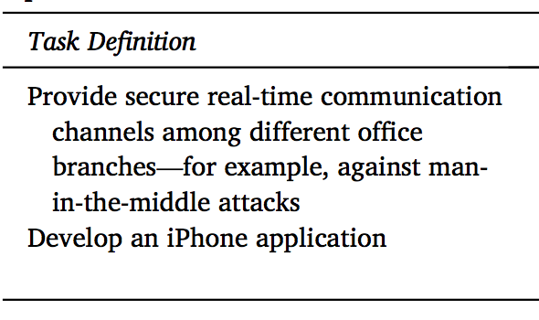
Experimental Design

Slide 6
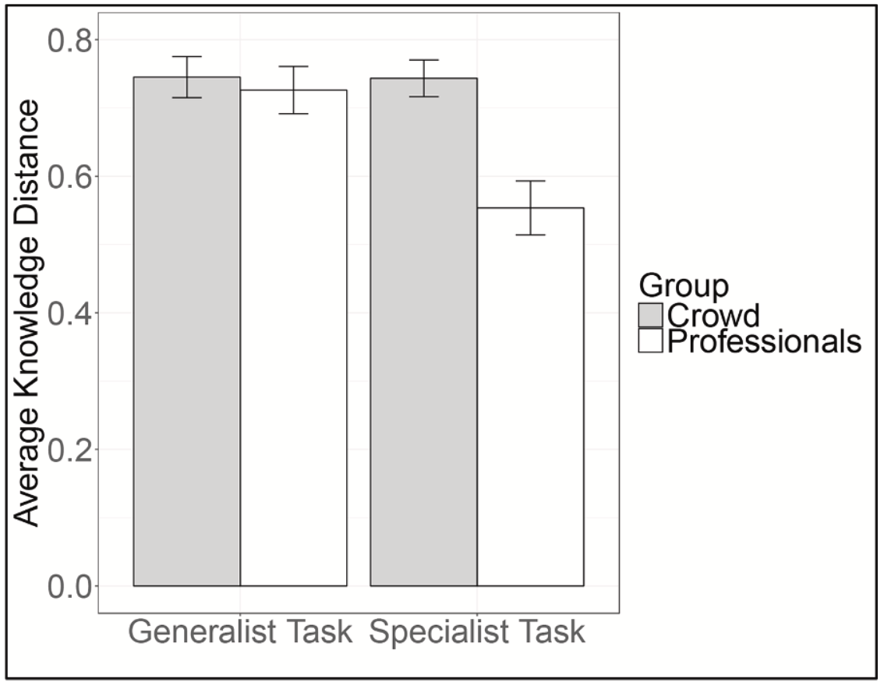
PreTests

Slide 7
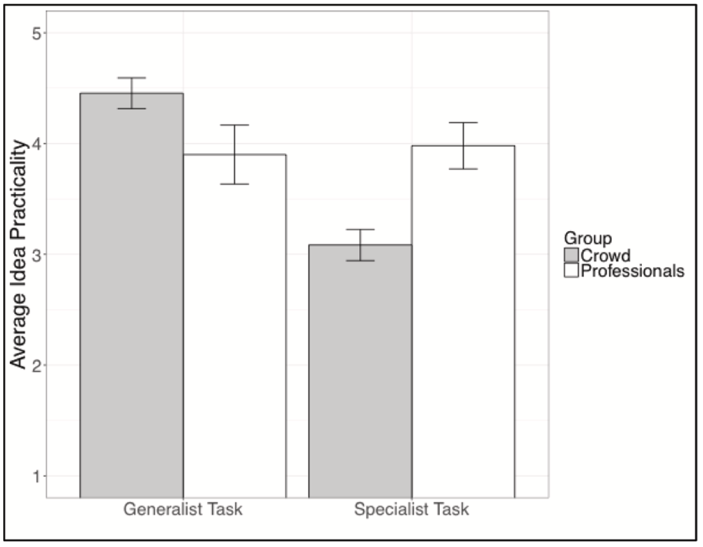
Findings

Slide 8
How to Break this Boundary?

Slide 9
Findings

Slide 10
Findings

Slide 11
What is next? – A theoretical perspective to explain the crowd’s creativity at the individual, team, and platform levels
Individual Level
Team Level
Platform Level
A gap to fill - A theoretical perspective to explain the crowd’s creativity is needed:
Surowiecki’s (2005) “wisdom of crowds” perspective
Afuah and Tucci’s (2012) “knowledge matching” perspective
A new perspective to explain the crowd’s creativity?
Amabile’s componential theory of creativity

Slide 12
Thank you.☺

