Slide 1


The Business Impact of Collective Online Behaviors
Jie Ren
Assistant Professor
Fordham University
Oct. 3rd, 2019

Slide 2
How does Web 2.0/3.0 affect your everyday life experience?

Slide 3
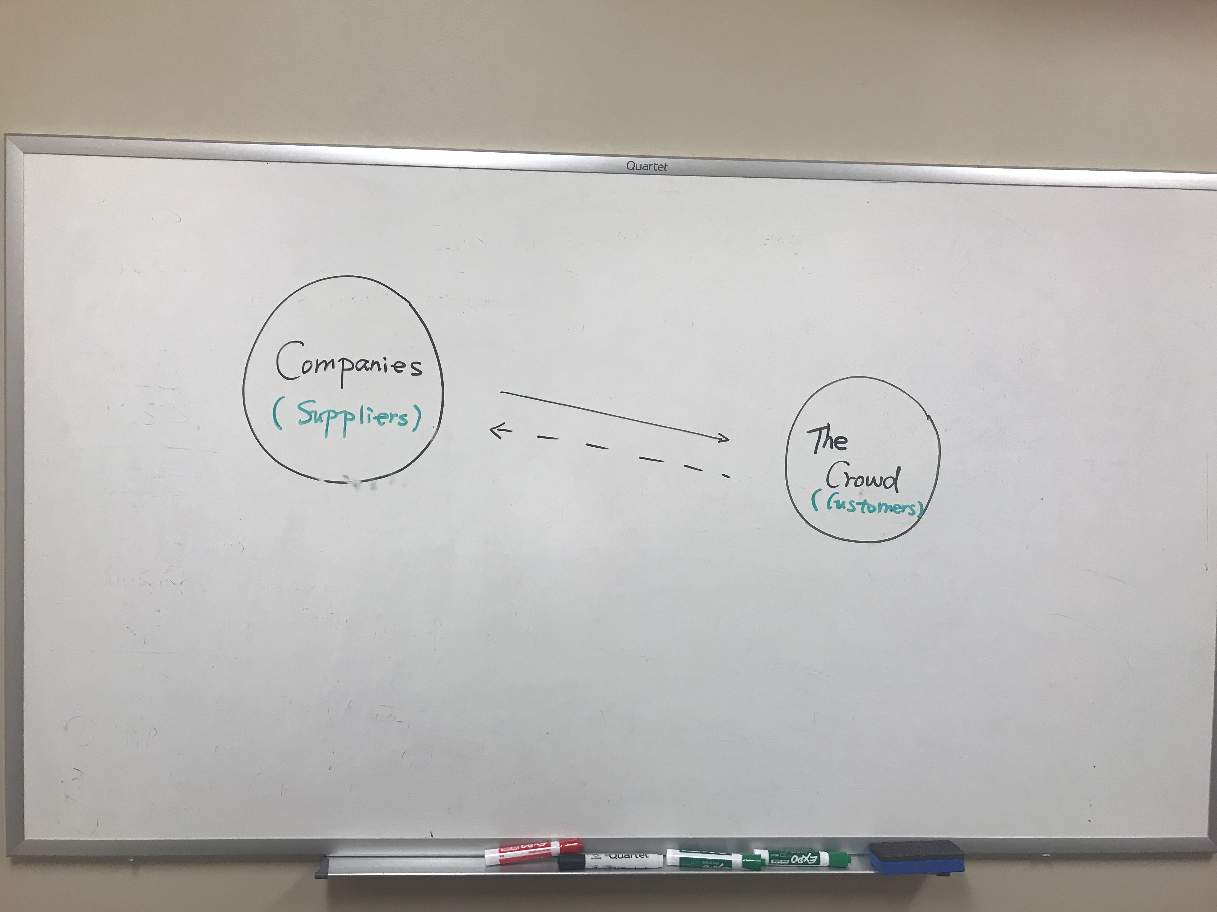
Old Economy

Slide 4
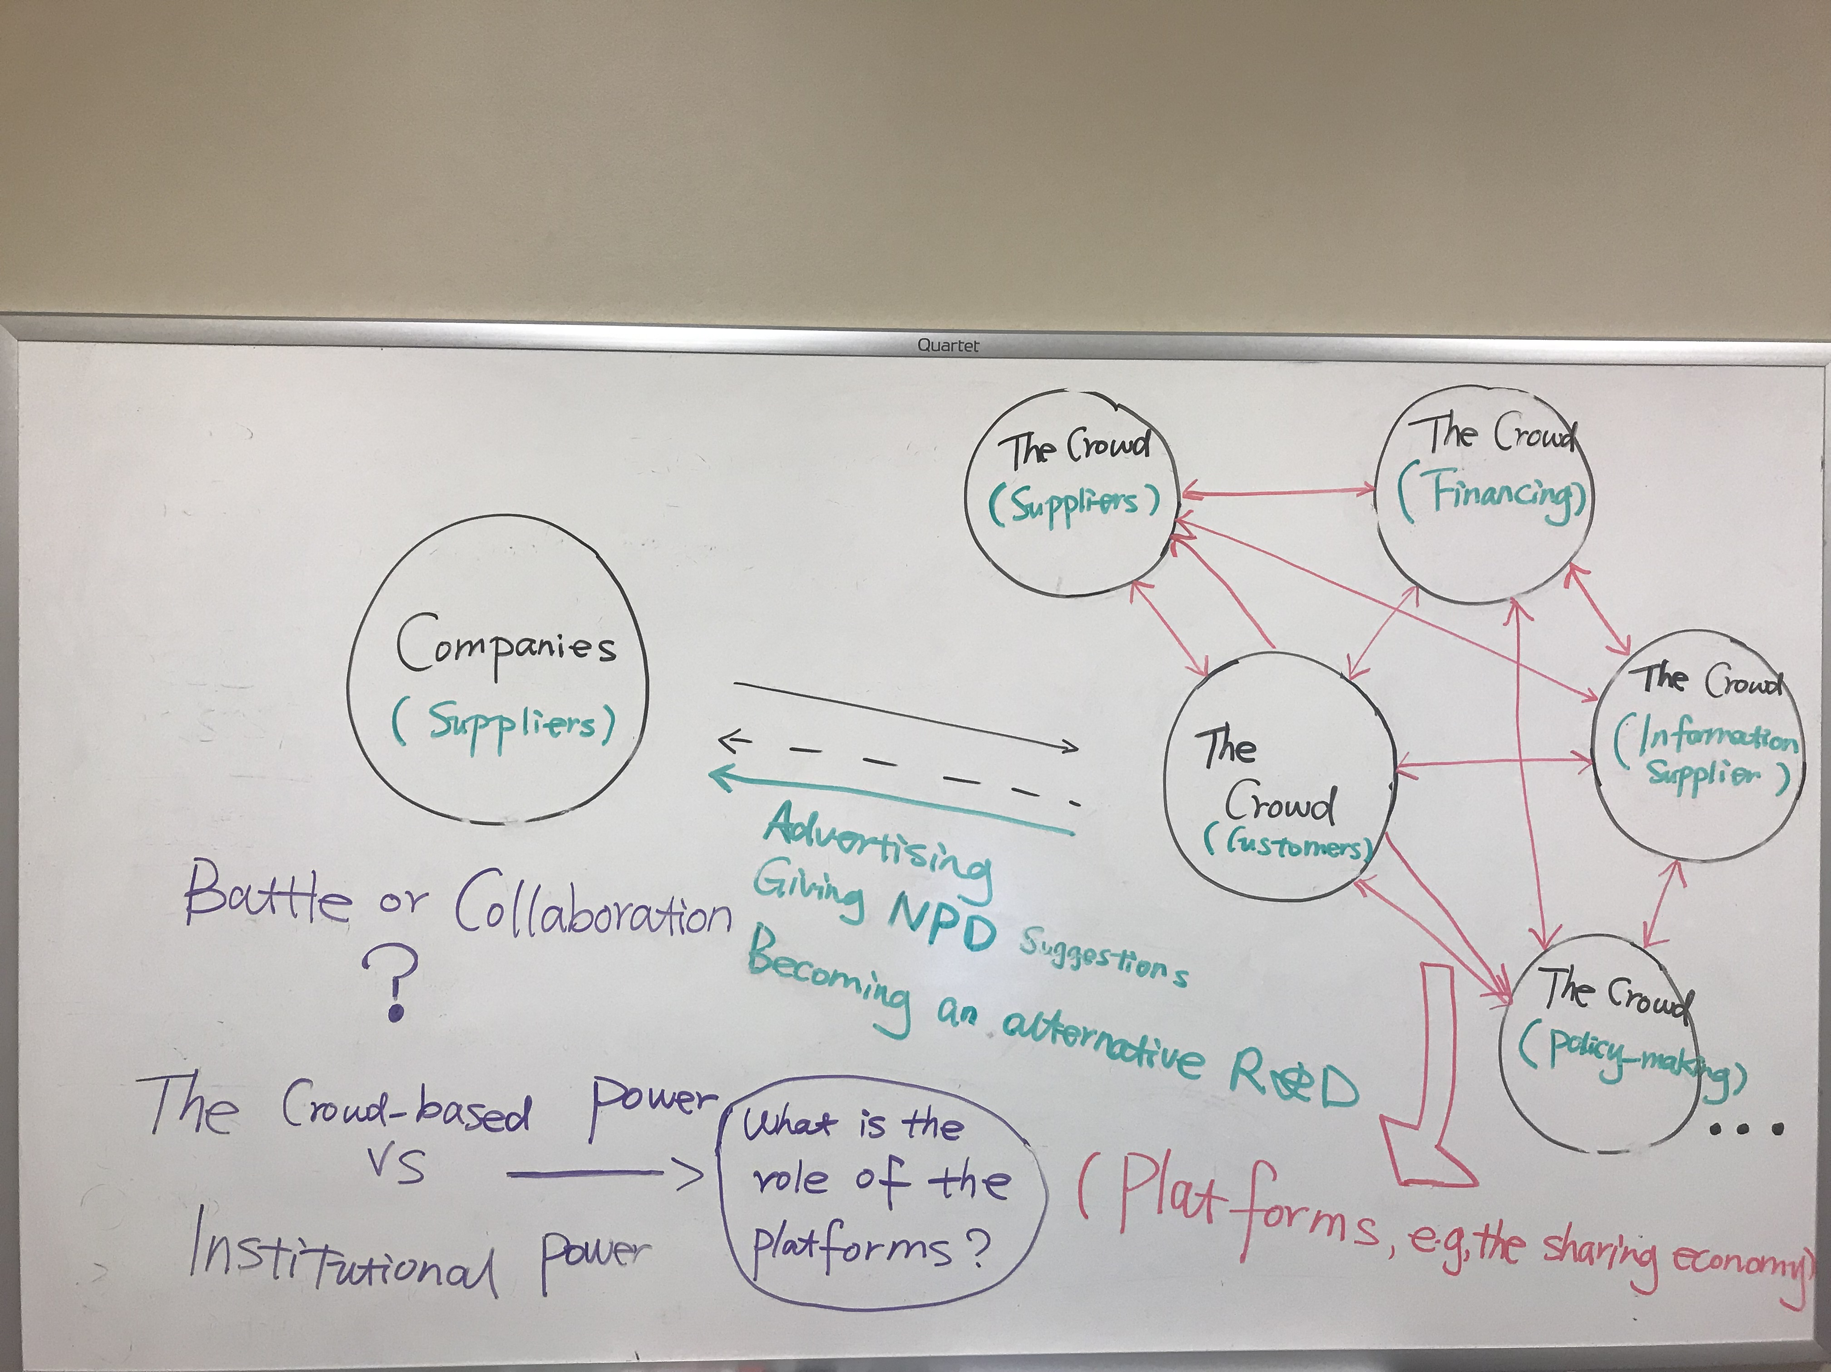
New Economy

Slide 5
Examples in This New Economy
Social media (e.g. Twitter, Facebook)
Online reviews (e.g., Amazon, Yelp)
Crowdsourcing (e.g., Mechanical Turk, Climate Colab, Kickstarter)
The sharing economy (e.g., Uber, Airbnb)
…

Slide 6
Study 1: Crowdsourcing
Definition:
  Crowdsourcing is the act of taking a job traditionally performed by employees and outsourcing it to an undefined, large group of people in the form of an open call.
How to increase the crowd’s capacity to innovate, potentially for companies?

Slide 7
Experimental Design
Participants: Mturkers
Tasks for them: Design a Facebook ad
Mechanisms of the experimental design:
  Genetic algorithm
Three conditions:
  Greenlight condition
  Combination condition
  Modification condition

Slide 8
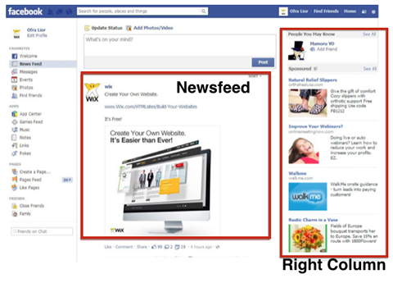
Facebook Design
Three elements:
  One title
  One text
  One image

Slide 9
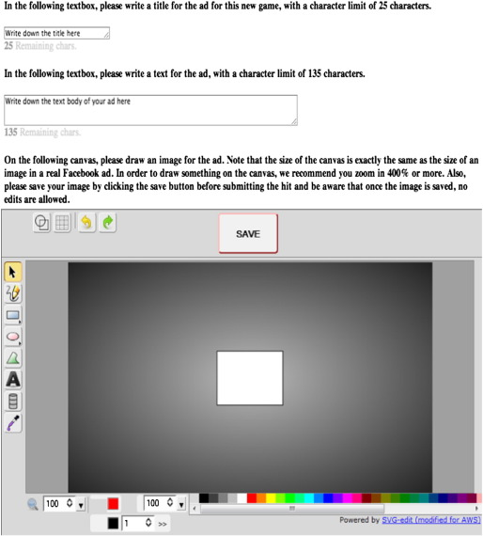
Condition 1: Greenlight

Slide 10
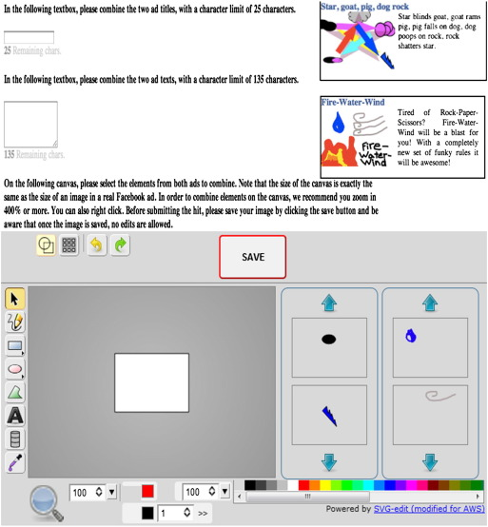
  Condition 2: Combination

Slide 11
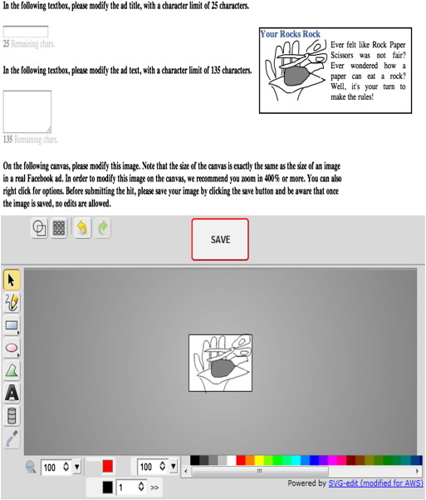
Condition 3: Modification

Slide 12
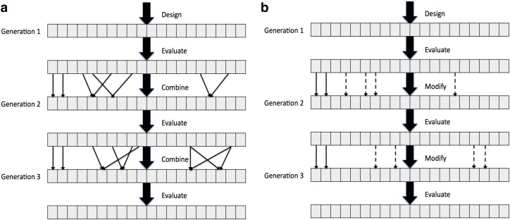
Comparison between the Three Conditions
Greenlight vs. Combination Modification

Slide 13
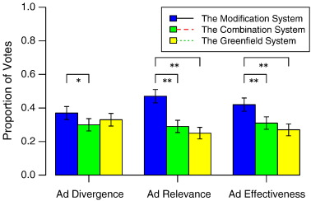
Results

Slide 14
Study 2: Online Review
How do online reviews affect product sales?

Slide 15
Study Design I
Data: Amazon
Volume & Valence
  Star ratings
Arousal
  Amazon review text
Sales
  Sales rank (normalized)

Slide 16
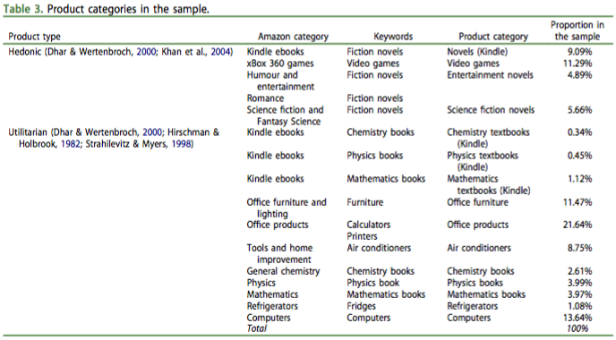
Study Design II

Slide 17
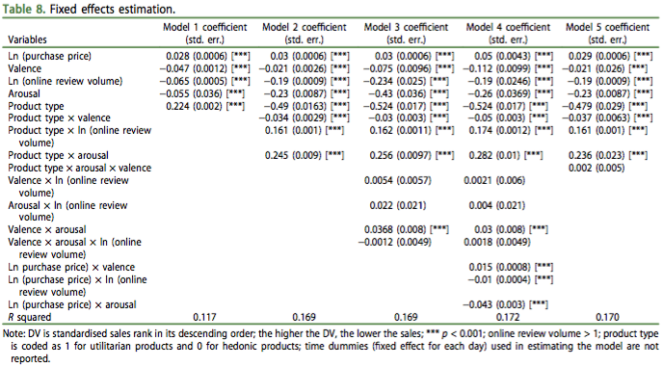
Results

Slide 18

Summary of Results
Online reviews (valence, volume and arousal) all positively affect sales.
  But this impact of volume and arousal is stronger for hedonic products than for utilitarian products.
  And this impact of valence is stronger for utilitarian products than for hedonic products.
Underlying mechanism
  Fast versus slow system
Image source: The New York Times

Slide 19
Study 3: Social Media
Is social media a good source of information compared to traditional news media?

Slide 20
Study Design
Data:
  Sina Weibo (Twitter) versus Sina Finance (Yahoo! Finance)
  Two years of data from 2013 to 2014
Variables of Information Quality:
  Information Coverage: Gini Coefficient
  The Predictive Value of Information in the Stock Market
  Stock Performance: Absolute Value of Stock Returns

Slide 21
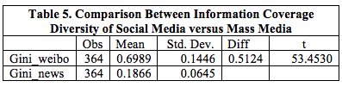
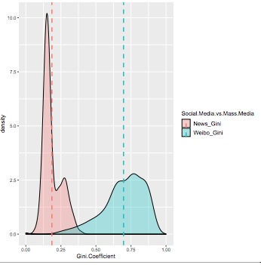
Results on Diversity of Information Coverage

Slide 22
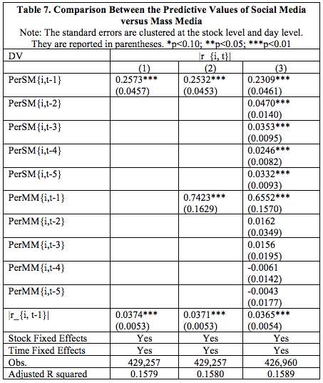
Results on Information Predictive
Value

Slide 23
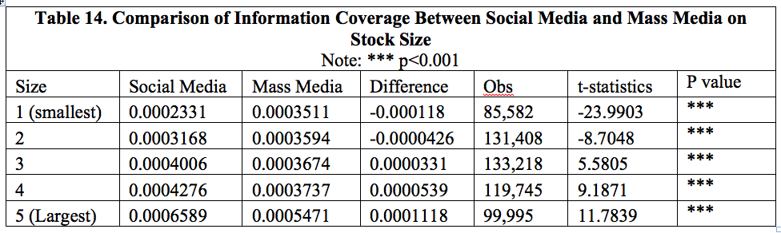
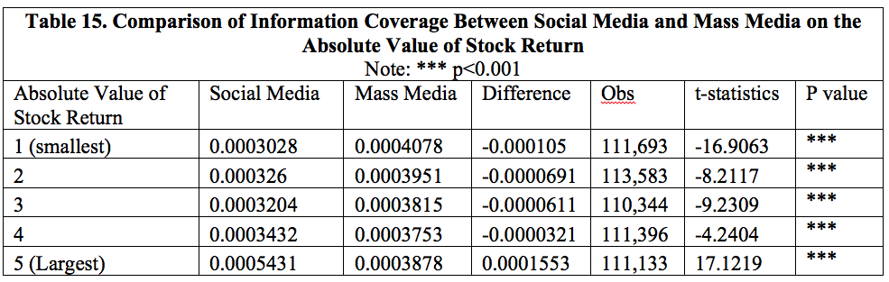
What Information Is Social Media Covering?
Mechanism for Results:
Social Influence

Slide 24
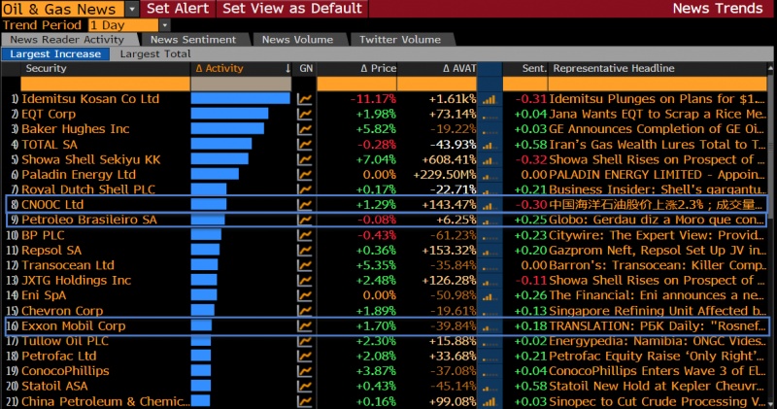
Suggestions for Practitioners

Slide 25
Where to Find the Studies?
Study 1:
  https://www.sciencedirect.com/science/article/pii/S0167923614001493
Study 2:
  https://www.tandfonline.com/doi/abs/10.1080/0960085X.2018.1524419?journalCode=tjis20
Study 3:
  https://papers.ssrn.com/sol3/papers.cfm?abstract_id=3434161

Slide 26
About Me
An assistant professor at Gabelli School of Business at Fordham University
Interested in understanding the crowd’s power that is fueling the new economy
My website:
  https://www.jieren.me/
Linkedin profile:
  https://www.linkedin.com/in/jie-ren-4109333a/
Facebook profile:
  https://www.facebook.com/jie.ren.3110?ref=bookmarks

Slide 27
Thank you!

